Slide 1

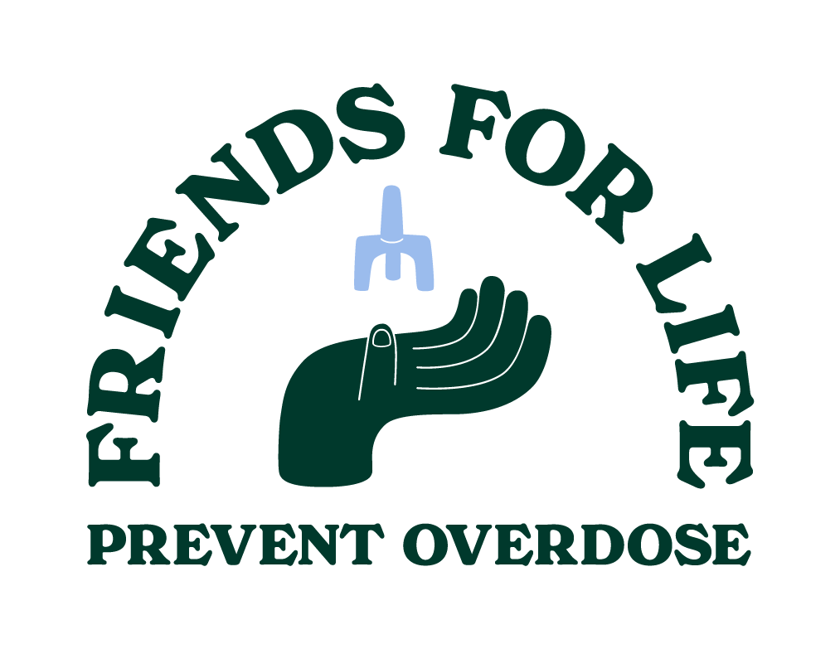

Facts about fentanyl: student edition (MS)
Notes:
SUGGESTED SCRIPT:
Hello, my name is [name] and I work as a [job title] with [employer]. Today we're going to be talking about what you and your friends need to know about illicit fentanyl and fake prescription pills. The goal of this presentation is for you to learn about
The ways you and your friends can learn the facts, stay safe and avoid opioids including illicit fentanyl

Slide 2
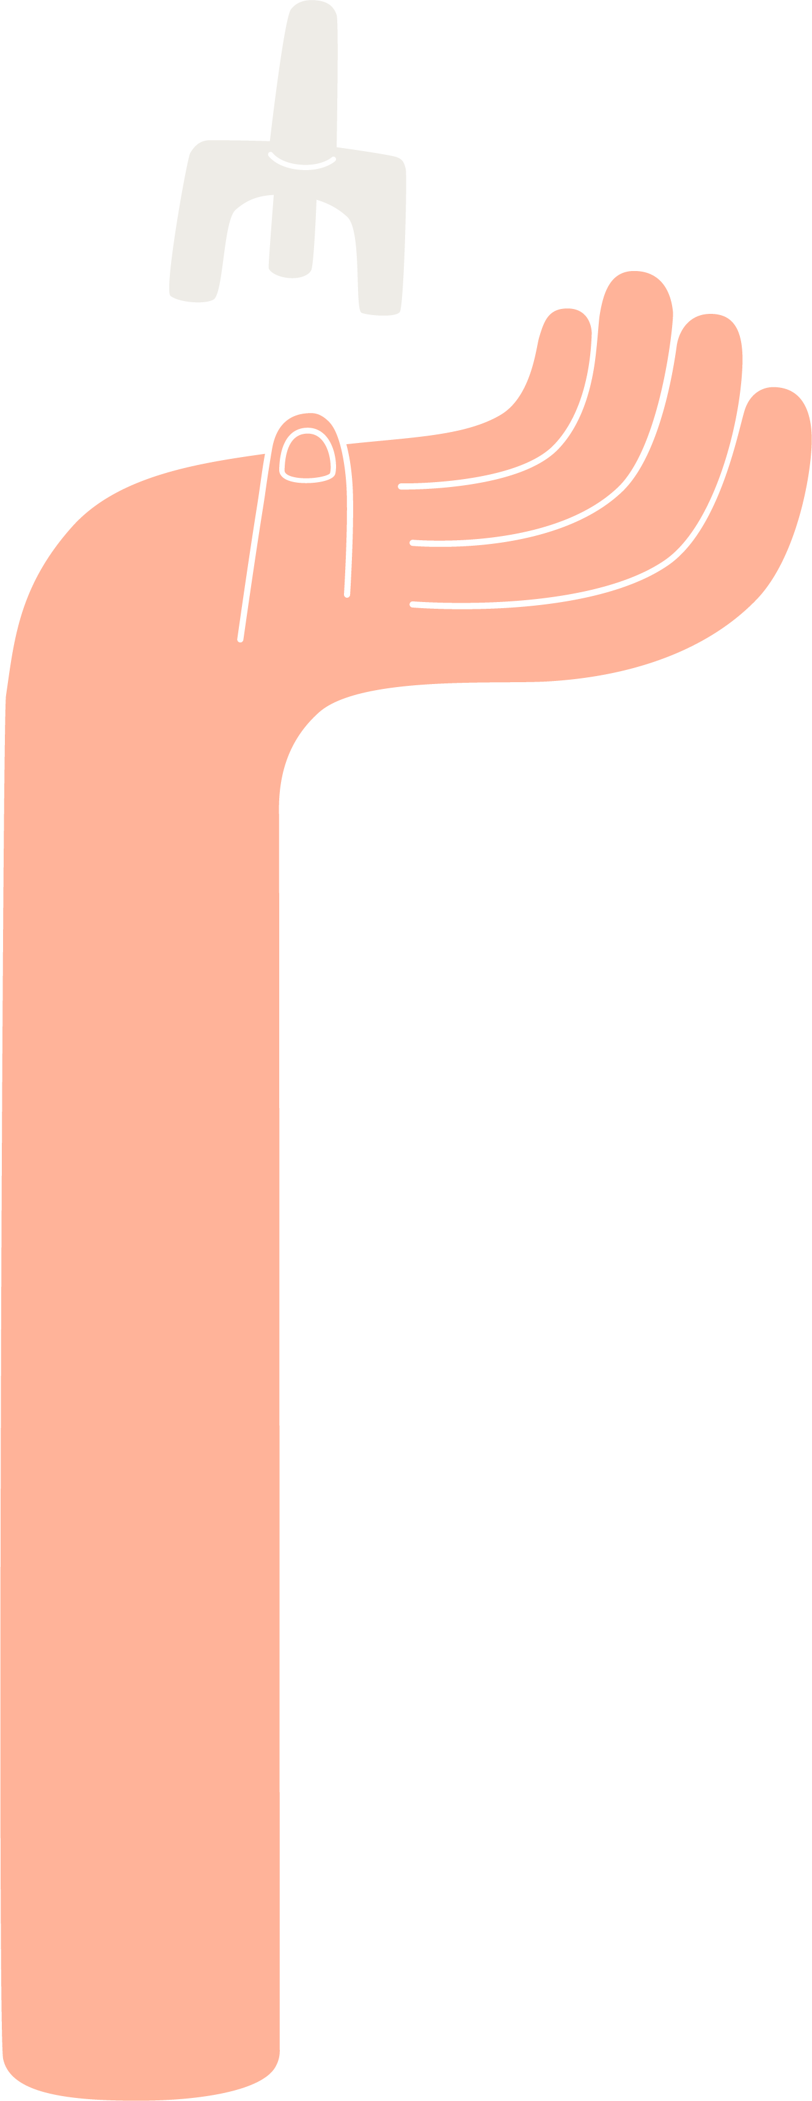
What we’ll cover
Basics about opioids, fentanyl,
and naloxone (Narcan)
How this issue affects people your age
How to help keep your friends and
yourself safe
Notes:
SUGGESTED SCRIPT:
Here's what we're going to cover
The basics about opioids and fentanyl, including how this issue affects people your age
What you and your friends need to know about avoiding opioids altogether and
Information about naloxone (or Narcan), a medication that helps reverse an opioid overdose
[NOTE: Ask, "Does anyone have any questions before we begin?"]

Slide 3
Basics about opioids
Regulated (legal) opioids: ​
​Highly controlled​
​Made in official labs​
​The amount of medicine in each pill is the same​
​Prescribed by doctors​
​Given out by pharmacies
Unregulated (illicit) opioids: ​​
Uncontrolled​​
​Made in underground labs​​
​The amount of medicine in each pill is different and impossible to predict​
​Sold on the streets or
social media
Notes:
SUGGESTED SCRIPT:
By a show of hands, how many of you have heard of fentanyl? How many of have heard of opioids or think you might know what they do? [NOTE: If some students raise their hands, field some additional responses. Ask: "What is fentanyl?" or "Where have you heard about it?" or "What is an opioid?" This will give you a sense of what students already know about this topic.]
Just to make sure we all have the same facts, I want to briefly touch on the basics.
Opioids are a type of drug used to manage and get rid of pain. They work by binding, or attaching, to nerve receptors in the brain, spinal cord, and other organs.
Regulated (legal) opioids, are medications prescribed by doctors, usually following surgeries or injuries or as part of cancer treatment.
Unregulated (illicit) opioids are sold by drug dealers on the streets or on social media.
There are several big differences between regulated (legal) opioids and unregulated (illicit) opioids. These differences are about:
how and where these opioids are made
where and by whom they are given out
These measures are designed to help keep people safe.
Part of what makes unregulated opioids like illicit fentanyl so harmful is that it is made in uncontrolled environments where the strength of each batch of pills, or even each individual pill, can be very different and impossible to predict. Some pills may have very little illicit fentanyl in them, some have lethal doses in them, and there's no way to tell.

Slide 4
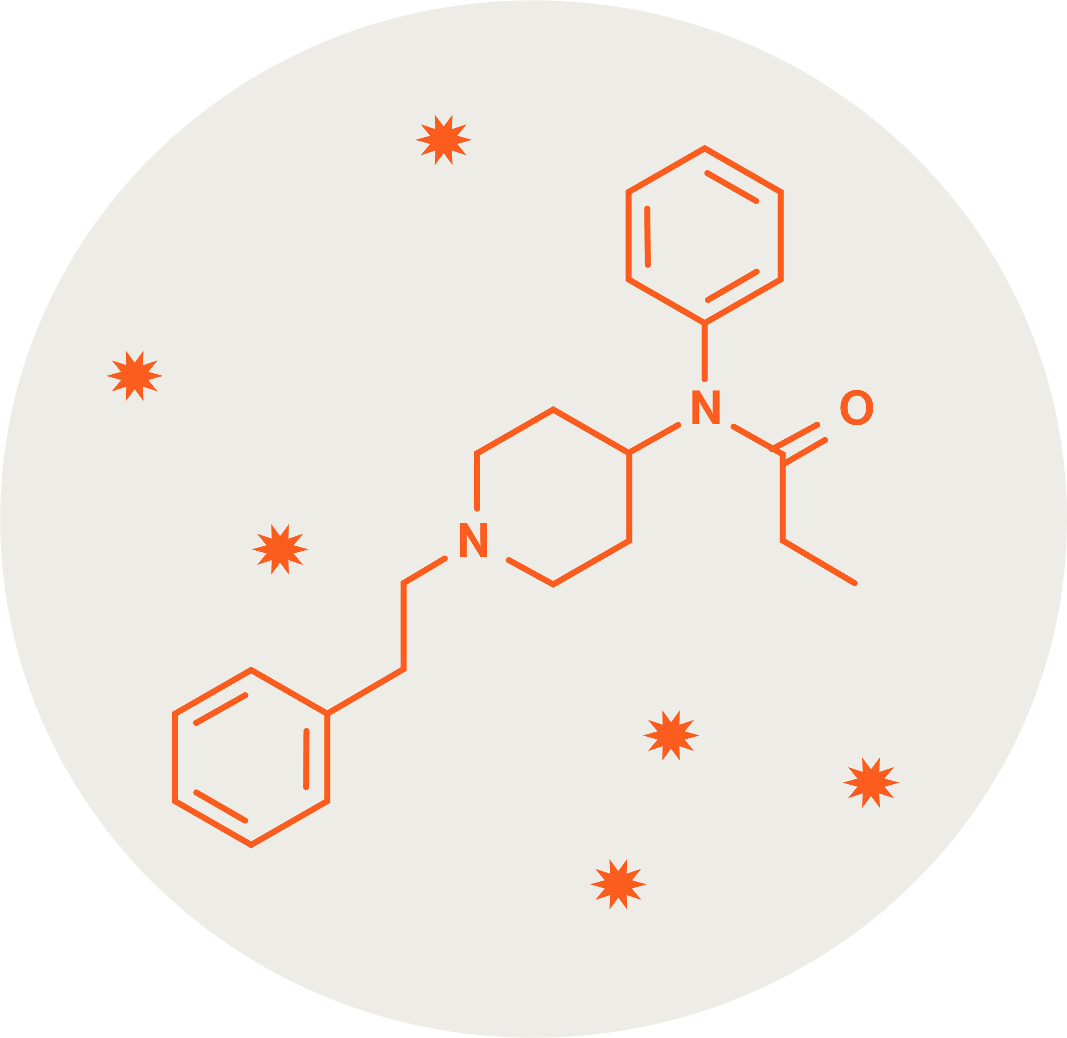
Basics about opioids
All opioids, whether regulated (legal)
or unregulated (illicit), share some
effects in common. They:
Relieve pain
Cause sleepiness
Slow down breathing
Opioids can also be habit-forming.
Notes:
SUGGESTED SCRIPT:
The main effect of any opioid is pain relief. Two side effects are sleepiness and slowed down breathing.
When someone is experiencing an opioid overdose, they appear to be sleeping, but they cannot wake up, even when they're shaken or yelled at. Another sign a person has overdosed is that their skin begins to turn blue, gray, or purple, because they're not getting enough oxygen.
Opioids can be habit-forming or addictive, especially if they're misused, like being taken in large doses, too often, or as a way to get high.

Slide 5

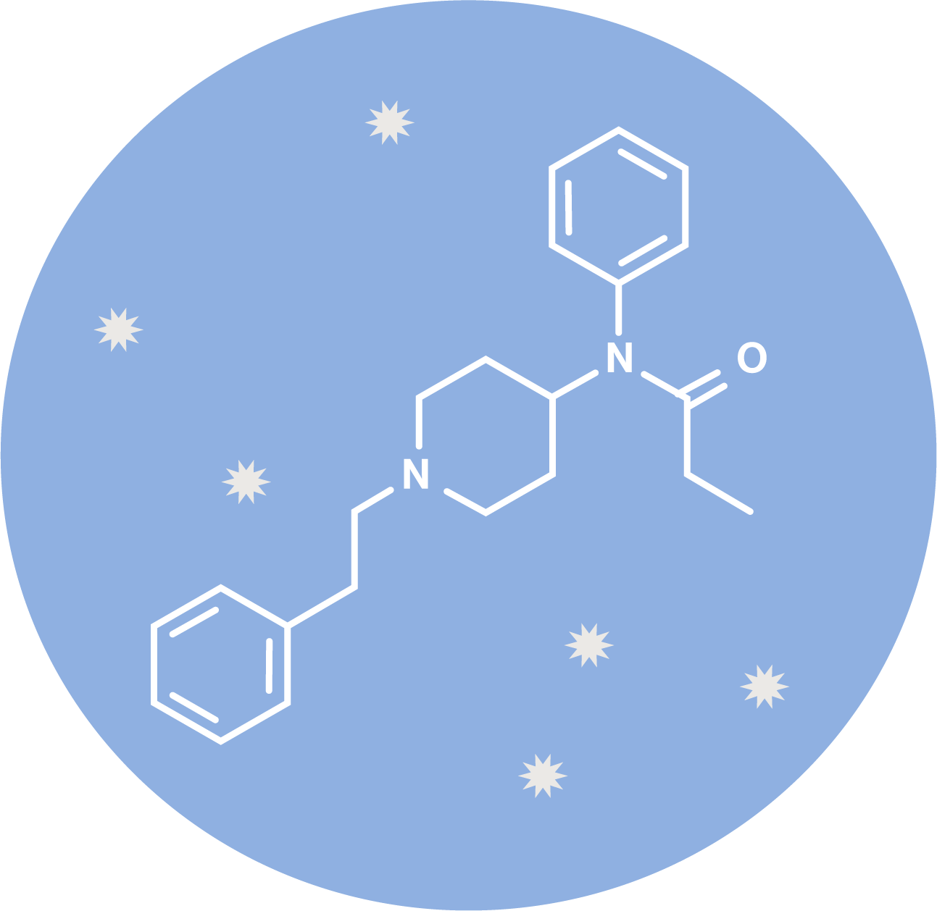
Basics about fentanyl
Fentanyl is a powerful, fast-acting opioid 50 – 100 times stronger than other opioids.
  Regulated (legal) fentanyl is
  used in hospitals or medical settings
  Unregulated (illicit) fentanyl
  is sold on the streets
    Pills can look like real prescription medication
    Powder can be mixed into other drugs​
Notes:
SUGGESTED SCRIPT:
Fentanyl is a powerful, fast-acting opioid that is much stronger than other opioids.
Illicit fentanyl is sold on the streets or on social media, usually as a pill or powder. It can be pressed into pills that look just like real prescription OxyContin, Adderall, Xanax, Percocet, and more. These fake pills laced with fentanyl are nearly impossible to tell apart from the real prescription pills they look like.
It can also be mixed as a powder into other illicit drugs.
Because illicit fentanyl is so strong, a tiny amount can cause an overdose, and because it is fast-acting, those overdoses tend to set in very quickly.

Slide 6
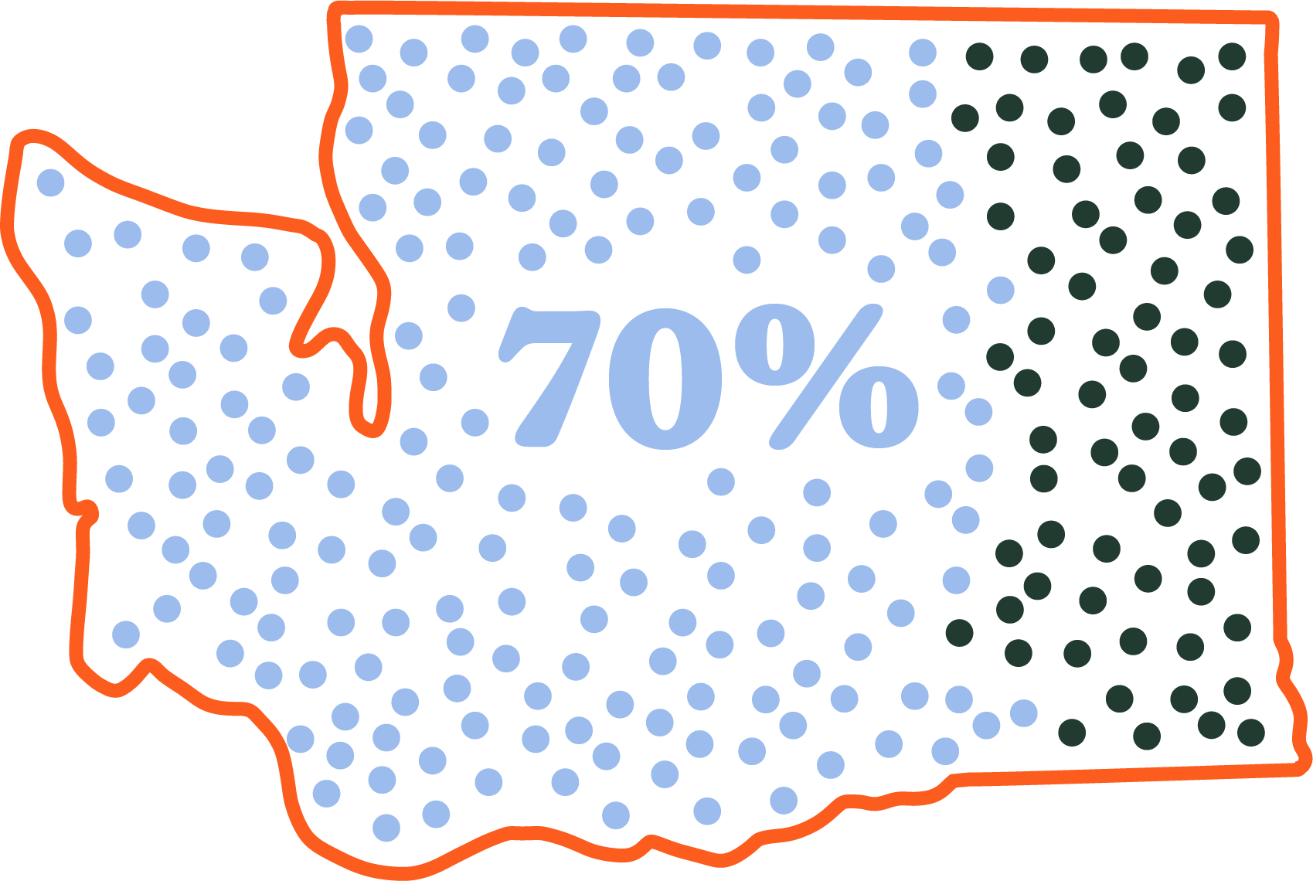
How this affects
people your age
70% of overdose deaths in Washington involve fentanyl.
The rate of youth overdose
has increased in recent years.
Many youth overdoses are accidental.
Yet, most teens (99%) say they do not use prescription pills to get high.
​
Source: DOH Overdose Dashboard and Health Youth Survey
Notes:
SUGGESTED SCRIPT:
Here's what you need to know about this issue is affecting young people in Washington:
In Washington and across the U.S., illicit fentanyl is making street drugs more unpredictable and harmful.
The rate of youth overdose has increased in recent years, and illicit fentanyl is a big part of the reason why.
HOWEVER, most teens are not actively seeking out or knowingly experimenting with opioids, including fentanyl. And the overall number of people under 18 in Washington who have died from a fentanyl overdose remains relatively low.
Still, one life lost is one too many. Fentanyl is hurting the people we care about, and just by knowing the facts and educating others, we can help keep one another safe.

Slide 7

How this affects
people your age
99%
Both statements are true:
Most teens (99%) don't experiment
with pills.
Illicit fentanyl is so unpredictable and is showing up in so many
fake pills and other drugs that the number of young people who accidentally overdose or die is quickly rising.
​
Source: DOH Overdose Dashboard and Health Youth Survey
Notes:
SUGGESTED SCRIPT:
Here's what I want you to take away from these slides:
The risks of illicit fentanyl are very real. Fentanyl is increasing overdose and death rates for young people across Washington.
AT THE SAME TIME, most young people are not intentionally taking fentanyl. In fact, most young people report that they don't experiment with pills of any kind.
BUT because illicit fentanyl is so harmful, it is still important for everyone (including all of you!) to understand the risks of illicit fentanyl and know how to avoid it.

Slide 8
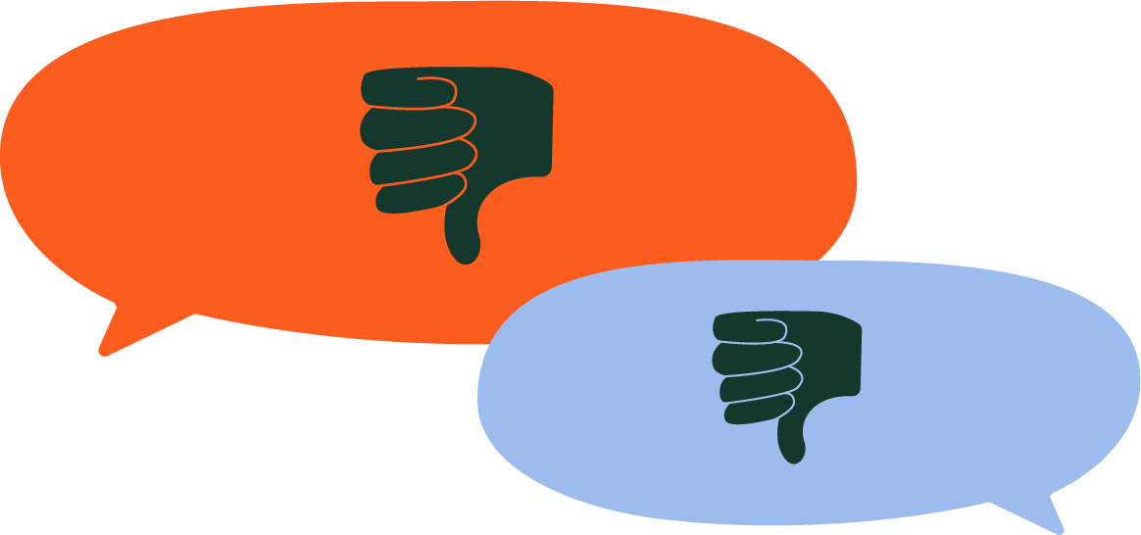
What you
can do to help
Don't take or share pills that are not prescribed to you.
Use practical refusal skills.
Learn the difference between positive and negative peer pressure.
Be a friend to others.
​
Notes:
SUGGESTED SCRIPT:
As you can see, the issues of illicit fentanyl and opioid overdoses affect not just people across our state but people across the entire country. These are not small problems. But that doesn't mean we are powerless. In fact, the opposite is true. Each and every one of you are powerful and have a voice. You absolutely can and should be part of the solution.
Every small action you take adds up to make a big difference, not just in your life, but in the lives of your friends and loved ones too.
These actions include:
Not taking or sharing pills that aren't prescribed to you
Using practical refusal skills
Learning to recognize the difference between positive and negative peer pressure
Being a friend to others

Slide 9

Don’t take
or share pills
Illicit fentanyl can be in fake prescription pills that look like Adderall, OxyContin, Percocet, or Xanax.
These fake pills are how most young people encounter fentanyl.
One of the best ways you can make sure you don't accidentally take fentanyl is to avoid prescription pills that don't belong to you.
​
Notes:
SUGGESTED SCRIPT:
The majority of young people who encounter fentanyl do so accidentally – mistaking fake pills for real prescription pills like OxyContin, Adderall, Xanax, or Percocet.
They typically access these pills on social media or from friends who may or may not know that the pill has fentanyl in it.
One of the simplest and best ways you can make sure you and your friends don't accidentally come into contact with fentanyl is to never take or share pills that have not been prescribed to you. Any pill that wasn't prescribed to you by a doctor may contain fentanyl and put you at risk of an overdose or death.

Slide 10





-
Using refusal skills
Make an excuse
Avoid the situation
Send a signal
Pass the blame
Offer an alternative
Be honest
Be an advocate
Notes:
SUGGESTED SCRIPT:
Refusal skills are practical ways you can refuse offers to try pills or other drugs or to avoid situations where people may be using pills to get high. You probably won't feel comfortable using all of these, but choose one or two that feel like something you could use if you find yourself in a situation where you need them. They work in many other situations where you feel pressured to do something you don't want to. Also, you might be able to teach one or more of these to a friend who could use this information to stay safe.
Send a signal
Agree on a code you can text or call your parent or caregiver with to come pick you up ASAP. This can be a code word or phrase or an emoji.
Pass the blame
Pass the blame to your parent or caregiver. Say, "I'd be grounded for life if my parents/caregivers found out."
Offer an alternative
Suggest a different activity like getting something to eat, taking a walk, playing video games, etc. rather than trying pills or other drugs.
Make an excuse
This strategy sounds like, "I have a test tomorrow," or "I have sports practice I can't miss," or "I have family coming in from out of town." Some excuse to explain why you don't want to try whatever you're being offered.
Avoid the situation
This is simply about not going places or hanging around people who are likely to be trying pills or any other drugs. It could mean declining an invitation to a party or avoiding going to a certain person's house.
Be honest
At the end of the day, "No." is a complete sentence. It's OK to be honest and say you simply do not want to try whatever you're being offered. You don't owe anyone an explanation. That being said, this one may feel hard to do in the face of pressure, but it does work.
Be an advocate
Your friends care what you think, and you have more influence than you know. If you're ever in a position to refuse an offer to use drugs, you can take it a step beyond these other skills and actually share what you know about the risks of trying pills or other drugs. Every single time you stand up for yourself, you give other people permission to do the same thing. Your strength makes other people stronger too. Remember that.
[NOTE: Optional pair share, "Take 2 minutes to turn to a neighbor and talk about which one of these refusal skills you'd be most likely to use and why."]

Slide 11
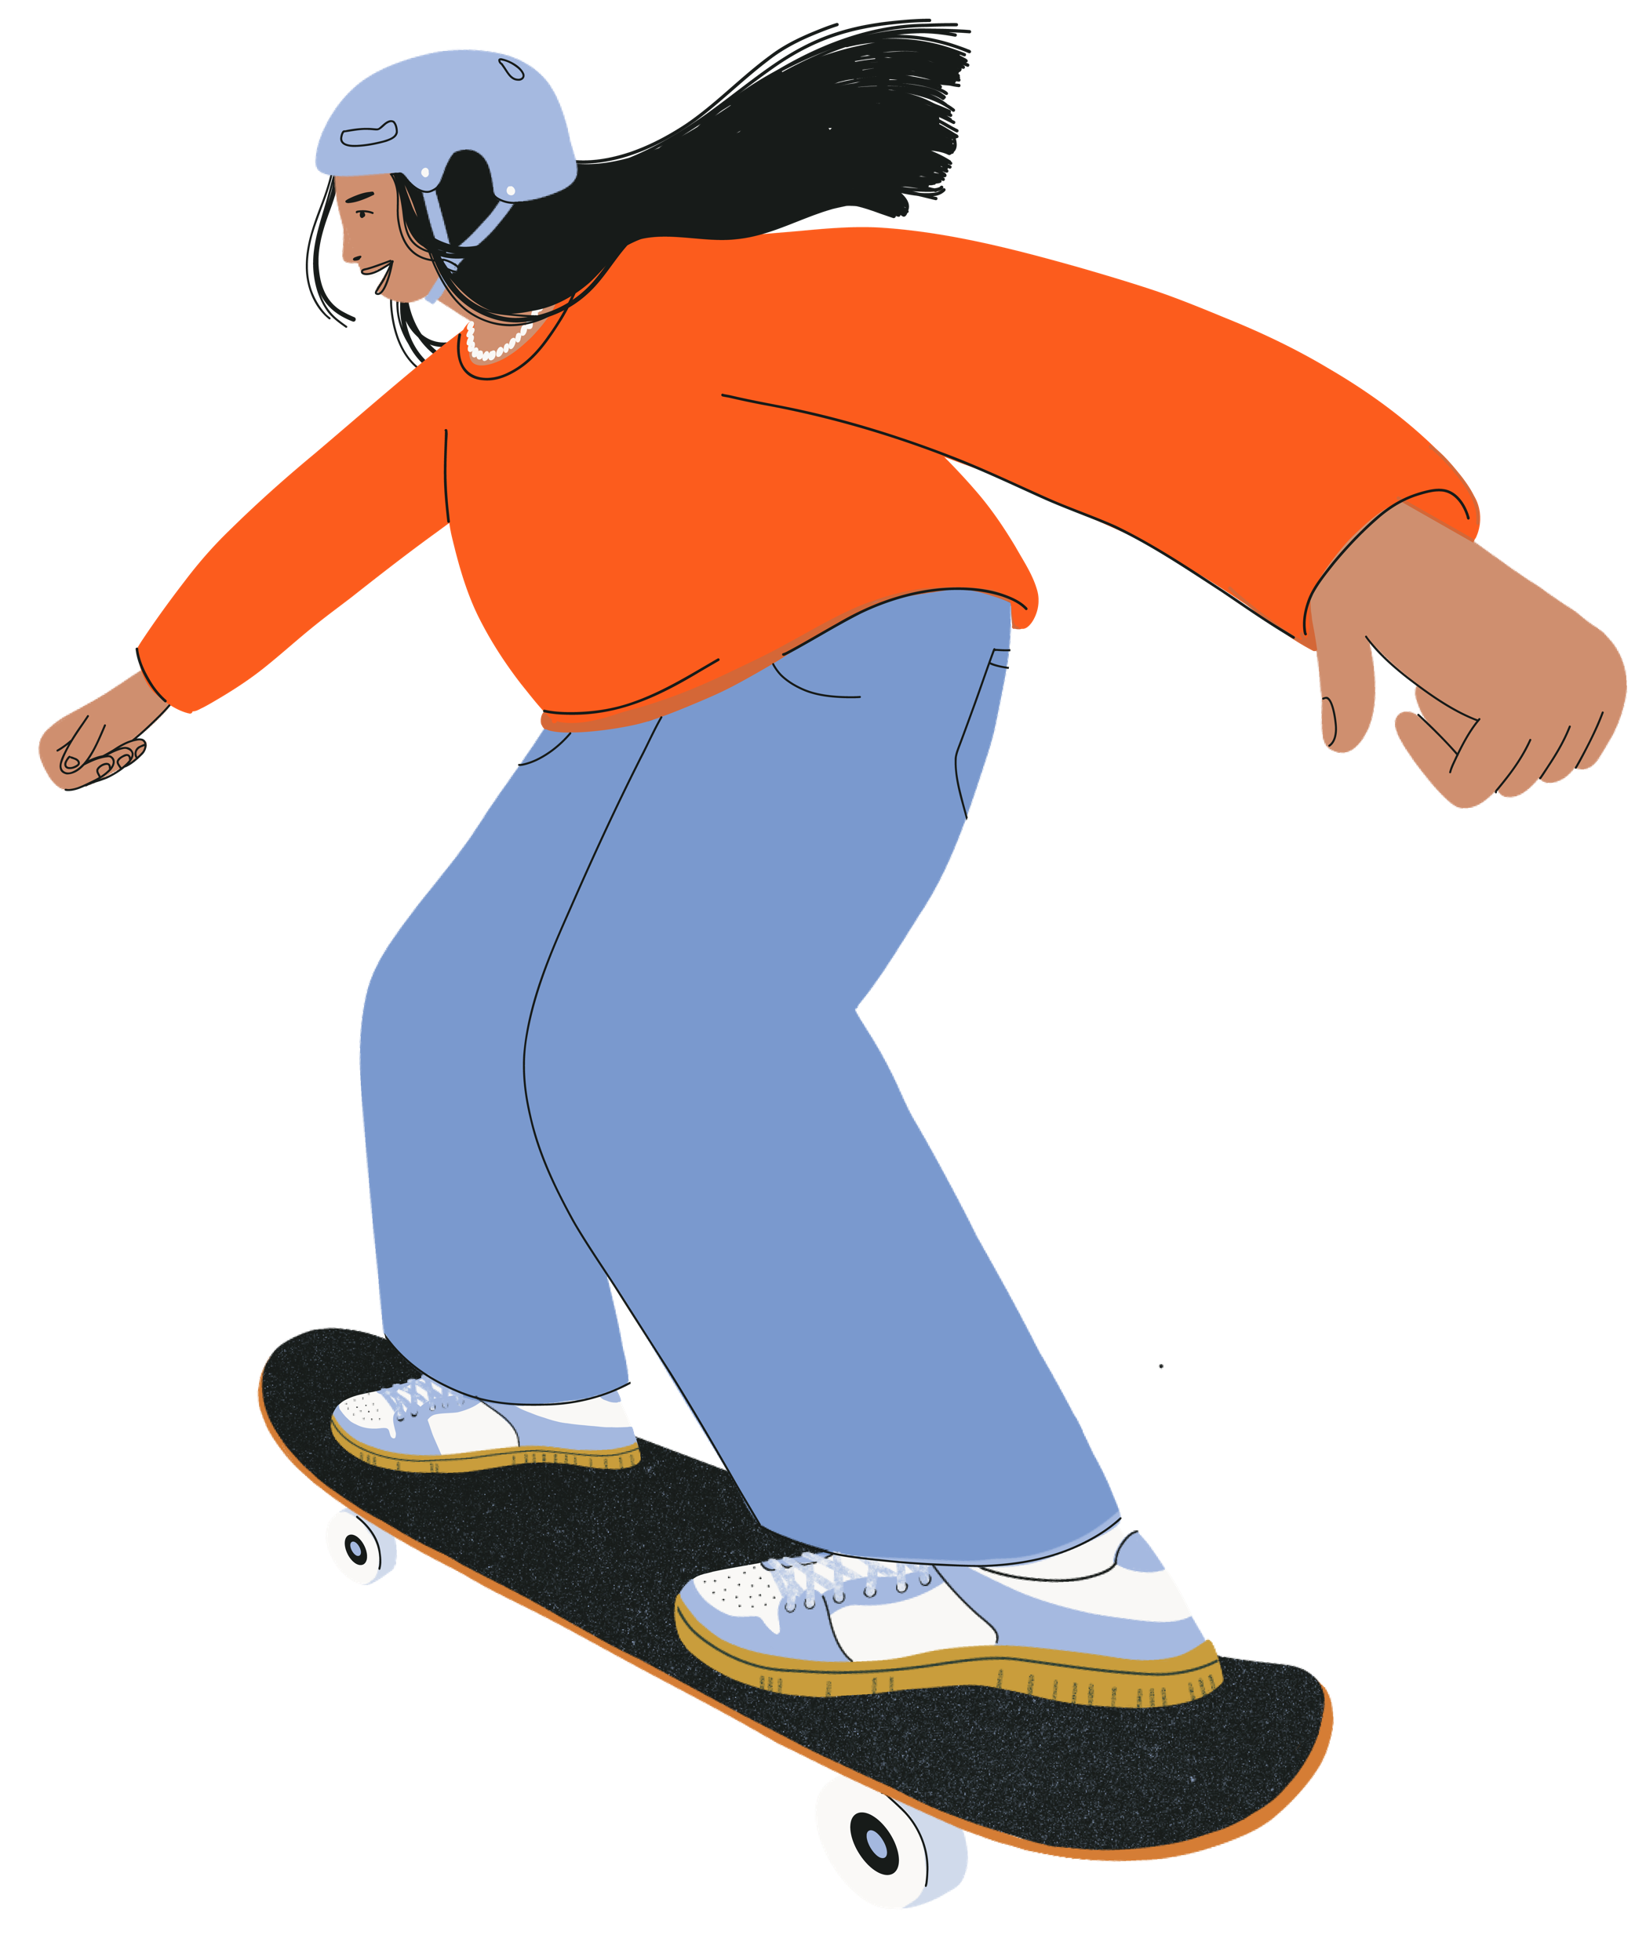
Peer pressure
isn’t all bad.
And it’s
important
to know the
difference.
Positive
Convincing a friend to
study to help them get
better grades.
Encouraging a friend to try out for a sport or another after-school activity.
Pushing your friend to try something outside of their comfort zone.
Notes:
SUGGESTED SCRIPT:
There's a reason this campaign is called Friends for Life, and it's because every healthy and happy friendship you have helps protect you and lowers the risk that you'll ever experiment with pills or any other drugs. And when you truly show up for your friends, you help protect them too.
Peer pressure is often talked about as a bad thing you should avoid at all costs, but that's not true. Positive peer pressure can motivate you to grow, to try new things, and to discover things about yourself. Learning the difference between positive and negative peer pressure will also help you learn to tell who you want to spend time with. The simple fact is friends won't put pressure on you to take risks that could really hurt you or cause you to go against your values.
These are some examples of positive and negative peer pressure.

Slide 12
Peer pressure
isn’t all bad.
And it’s
important
to know the
difference.
Negative
Convincing someone to
skip class or school.
Encouraging someone to bully or gossip about one of your classmates.
Pushing someone to take an unsafe risk, especially with things like drinking or drugs that can cause real harm.
Notes:
SUGGESTED SCRIPT:
[NOTE: Ask, "What are some other positive examples you can think of? What about negative? How can you tell the difference between positive and negative peer pressure?" Students' responses will differ, but the goal is that students understand that positive and negative peer pressure are likely to produce different outcomes and will feel different to them (i.e., negative peer pressure may conflict with their values or make them feel nervous, anxious, or bad on the inside while positive pressure may motivate, challenge, or invigorate them).]

Slide 13
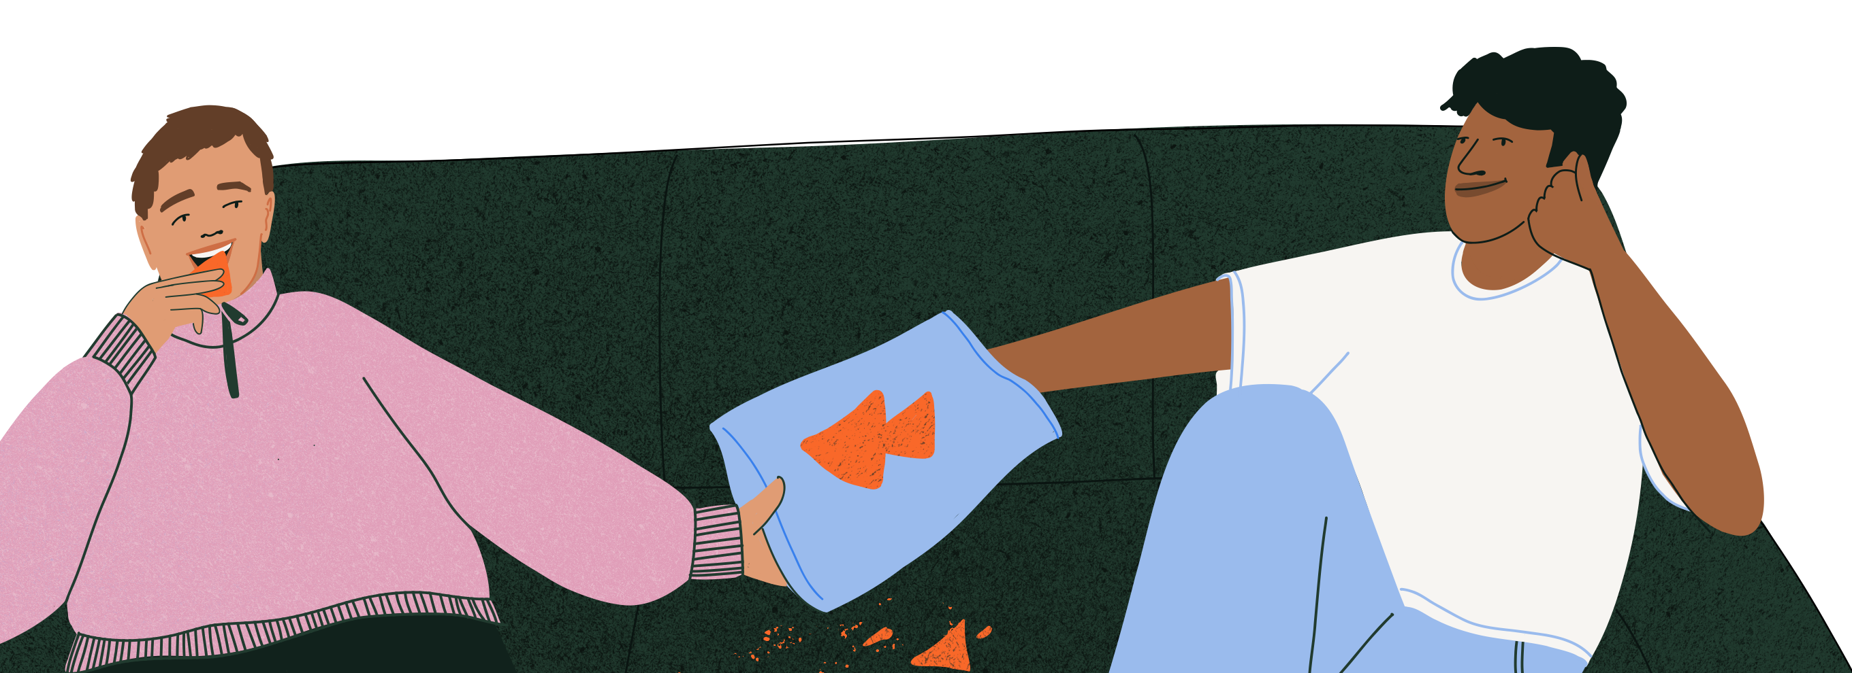
Building healthy friendships
As you meet new people
and form friendships, ask
yourself:
Does this person really seem to care about me?
Does this person respect me?
Is this person open and honest with me?
Does this person share or support my goals and values?
Your friends are a big part of your success and safety. And you are a big part of theirs too.
Notes:
SUGGESTED SCRIPT:
The friends you make during these years will influence your choices and your future. It's totally possible that the friendships you're making now will last you a lifetime.
At their best, these friendships give you a sense of belonging and help you learn to care for, respect, and communicate with others.
It's important to reflect on the qualities you want in a friend, what values are important to share (including not using pills or other drugs), and how you should expect to be treated in a healthy friendship.
[NOTE: Ask, "What other questions might you ask yourself to help you know whether someone is being a friend to you?"]

Slide 14

Activity time
Notes:
SUGGESTED SCRIPT:
Before we move on, we're going to complete a brief activity in groups. [PROCEED TO LESSON PLAN FOR MORE INFORMATION]

Slide 15
Risk factor
A behavior or condition, such as smoking or high blood pressure, that increases the possibility of sickness or injury.
Notes:
SUGGESTED SCRIPT:
Before we move on, we're going to complete a brief activity in groups. [PROCEED TO LESSON PLAN FOR MORE INFORMATION]

Slide 16
Understanding
risk factors
Mental Health
Teens experiencing mental or emotional pain may take pills to try to make the pain go away and are likely to be alone when they take them.
Physical Pain
Teens who have
been injured or are experiencing physical pain may try pills to help with the pain.
Social Pressure
Teens may experiment in social settings with peers who are drinking, taking pills, or using other drugs.
Notes:
SUGGESTED SCRIPT
One part of being a friend is recognizing when a friend might be struggling or might be at risk for experimenting with prescription pills (or what they believe to be prescription pills).
The three most common risk factors tend to be mental health challenges, physical pain, and social pressure.
If your friend isn’t acting like their usual self, try talking to them about what’s going on. Learn how you can be there for them. But know that you are not alone. If the problem is serious, you should talk to a trusted grown-up too.

Slide 17
Protective factor
Skills, strengths, resources, supports, or coping strategies that help people deal with stressful events or lower the risk of sickness or injury.
Notes:
SUGGESTED SCRIPT:
Before we move on, we're going to complete a brief activity in groups. [PROCEED TO LESSON PLAN FOR MORE INFORMATION]

Slide 18
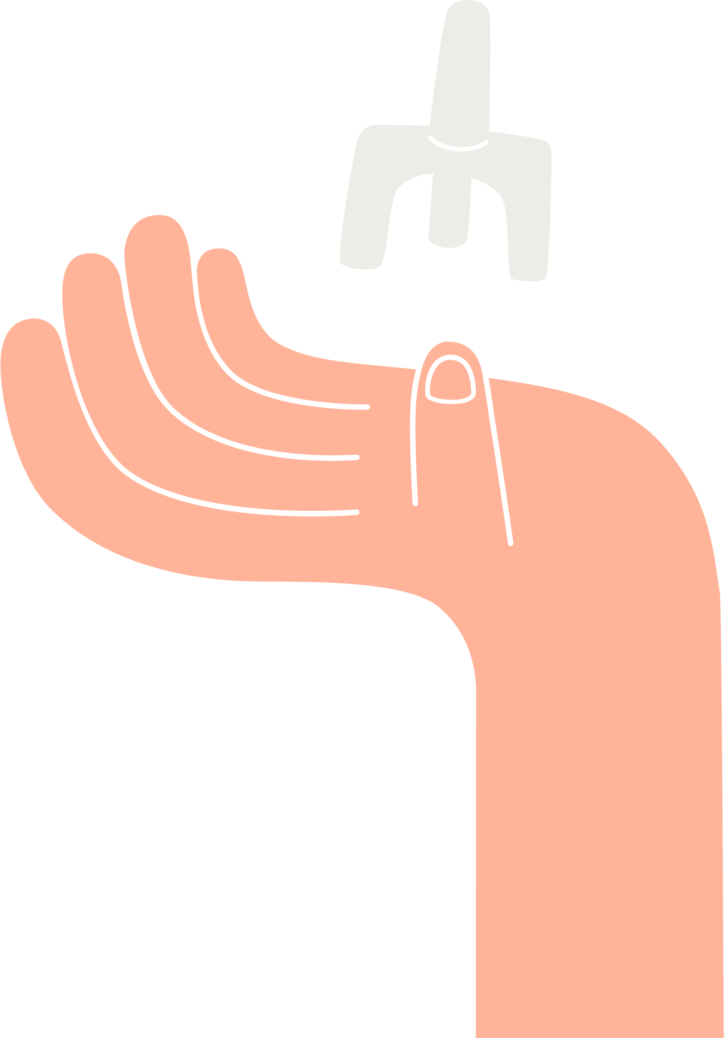

The basics
of naloxone
Naloxone (Narcan):
Also known as Narcan
Reverses opioid overdoses
Available most commonly
as a nasal spray
Washington state has
Good Samaritan laws so people who call 911 in the event of an overdose won’t get into legal trouble.
Notes:
SUGGESTED SCRIPT:
Naloxone, also known by the brand name Narcan, is a medication that reverses opioid overdoses. It is available most commonly as a nasal spray.
Naloxone is simple and safe to use. It is available to buy without a prescription/over-the-counter at stores like CVS, Rite Aid, and Walgreens.
Washington state also has laws called Good Samaritan Laws which protect people who call 911 in the event of an overdose from getting into legal trouble. If you believe someone has overdosed, you should ALWAYS call 911.

Slide 19
The basics
of naloxone
Naloxone (Narcan):
Blocks the effects of opioids to help wake someone up
Does not work to treat the effects of other drugs or alcohol
Has no effect on someone who is not on opioids
Is not habit-forming
Is the best tool we have to
save lives
Notes:
SUGGESTED SCRIPT:
Our brains have opioid receptors. Naloxone (or Narcan) is a type of medication called an opioid antagonist. What that means is it blocks opioids from binding, or attaching, to the receptors in our brain. If someone is overdosing on opioids, naloxone will help reverse the effects and help them wake up/start breathing again.
Naloxone has no effect on someone who is not on opioids, meaning even if you give it to someone and they are not overdosing, you cannot hurt them by giving them naloxone. It also does not work to treat the effects of other drugs or alcohol. It only works for opioids like illicit fentanyl.
Naloxone is the most effective tool we have to save lives in the event of an emergency.

Slide 20
Questions?
Thank you!
Visit WAFriendsForLife.com for more
Notes:
SUGGESTED SCRIPT:
Thank you so much for participating today. With your help, we can put an end to youth opioid overdoses. I am happy to answer any other questions you may have.

